Slide 1
Chapter 20.
Network Layer: Internet Protocol
20.1 Internetworking
20.2 IPv4
20.3 IPv6
Computer Networks
20-<number>

Slide 2

Link Layer Interconnection
Frame in data link layer does not carry any routing information
Problem: How does S1 know that data should be sent out from interface f3 ?
Computer Networks
20-<number>

Slide 3

Network Layer in an Internetwork
Network layer is responsible for host-to-host delivery and for routing the packets
Computer Networks
20-<number>

Slide 4


Network Layer
Computer Networks
20-<number>

Slide 5

Internet Protocol (IP)
Switching at the network layer in the Internet uses the datagram approach
Communication at the network layer in the Internet is connectionless
Position of IPv4 in TCP/IP protocol suite
Computer Networks
20-<number>

Slide 6

IPv4 Datagram
Computer Networks
20-<number>

Slide 7

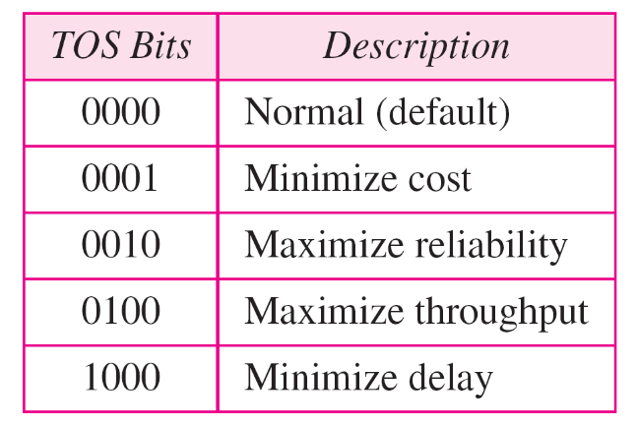
IPv4 Header
Version: IPv6, IPv4
Service type or differentiated services
  Precedence: never used
  TOS
Computer Networks
20-<number>

Slide 8

Default TOS for Applications

Slide 9

IPv4 Header
Total length: Length of data = total length – header length
  Maximum 65535 (2¹⁶ – 1) bytes
  Encapsulation of a small datagram in an Ethernet frame
  Identification: used in fragmentation
  Flag : used in fragmentation
  Fragmentation offset
  Time to live
  Checksum
  Source and destination address
Computer Networks
20-<number>

Slide 10


IPv4 Header
Protocol field for higher-level protocol
Computer Networks
20-<number>

Slide 11
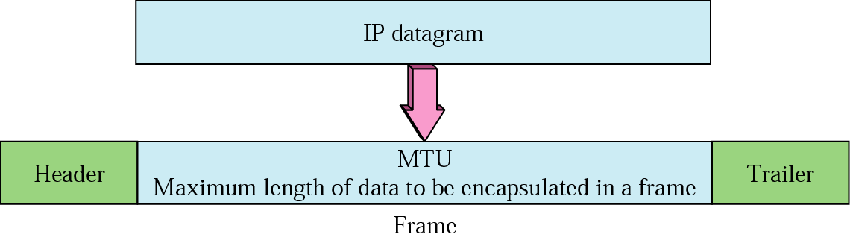

Fragmentation
Maximum length of the IPv4 datagram: 65,535 bytes
Computer Networks
20-<number>

Slide 12

Field related to fragmentation
Identification: identifies a datagram originating form the source host
Flags: the first bit (reserved), the second bit (do not fragment bit), the third bit (more fragment bit, 0 means this is the last or only fragment)
Fragmentation offset: (13 bits cannot represent a sequence of bytes greater than 8191
Computer Networks
20-<number>

Slide 13

Detailed Fragmentation Example
Computer Networks
20-<number>

Slide 14

Checksum
Computer Networks
20-<number>

Slide 15

Options
IPv4 header is made of two part: a fixed part and a variable part
Fixed part: 20 bytes long
Variable part comprises the options that can be a maximum of 40 bytes
Computer Networks
20-<number>

Slide 16
IPv6 address
The use of address space is inefficient
Minimum delay strategies and reservation of resources are required to accommodate real-time audio and video transmission
No security mechanism (encryption and authentication) is provided
IPv6 (IPng: Internetworking Protocol, next generation)
  Larger address space (128 bits)
  Better header format
  New options
  Allowance for extention
  Support for resource allocation: flow label to enable the source to request special handling of the packet
  Support for more security
Computer Networks
20-<number>

Slide 17

IPv6 Datagram
IPv6 defines three types of addresses: unicast, anycast (a group of computers with the same prefix address), and multicast
IPv6 datagram header and payload
Computer Networks
20-<number>

Slide 18

IPv6 Datagram Format
Computer Networks
20-<number>

Slide 19
IPv6 Header
Version: IPv6
Priority (4 bits): the priority of the packet with respect to traffic congestion
Flow label (3 bytes): to provide special handling for a particular flow of data
Payload length
Next header (8 bits): to define the header that follows the base header in the datagram
Hop limit: TTL in IPv4
Source address (16 bytes) and destination address (16 bytes): if source routing is used, the destination address field contains the address of the next router
Computer Networks
20-<number>

Slide 20
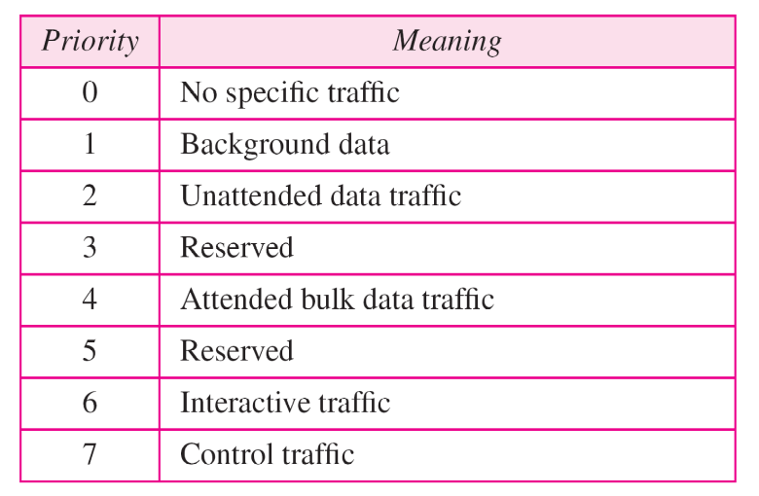
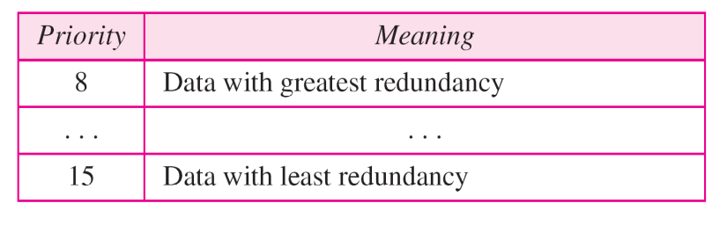
Priority
IPv6 divides traffic into two broad categories: congestion-controlled and noncongestion-controlled
Congestion-controlled traffic
Noncongestion-controlled traffic
Computer Networks
20-<number>

Slide 21

Comparison between IPv4 and IPv6
Computer Networks
20-<number>

Slide 22

Extension Header
Computer Networks
20-<number>

Slide 23

Three transition strategies from IPv4 to IPv6
Transition should be smooth to prevent any problems between IPv4 and IPv6 systems
Computer Networks
20-<number>

Slide 24

Dual stack
All hosts have a dual stack of protocols before migrating completely to version 6
Computer Networks
20-<number>

Slide 25

Tunneling
IPv6 packet is encapsulated in an IPv4 packet
Computer Networks
20-<number>

Slide 26

Header translation
Necessary when the majority of the Internet has moved to IPv6 but some systems still use IPv4
Header format must be changed totally through header translation
Computer Networks
20-<number>

